Slide 1
Lecture 11
Steps to connect to virtual machine
Instructor : Engr. Tehmeed

Slide 2
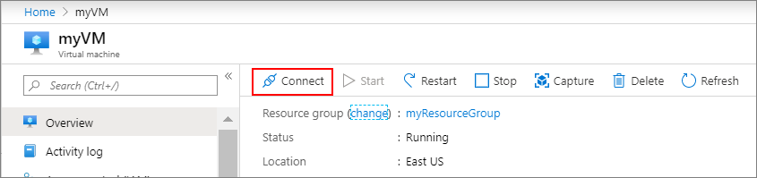
Connect to Windows Virtual Machine
Create a remote desktop connection to the virtual machine. These directions tell you how to connect to your VM from a Windows computer. On a Mac, you need an RDP client such as this Remote Desktop Client from the Mac App Store.
On the overview page for your virtual machine, select the Connect > RDP.

Slide 3
Connect to Virtual Machine
On the overview page for your virtual machine, select the Connect > RDP.
In the Connect with RDP tab, keep the default options to connect by IP address, over port 3389, and click Download RDP file.
Open the downloaded RDP file and click Connect when prompted.
In the Windows Security window, select More choices and then Use a different account. Type the username as localhost\username, enter the password you created for the virtual machine, and then click OK.
You may receive a certificate warning during the sign-in process. Click Yes or Continue to create the connection.

Slide 4
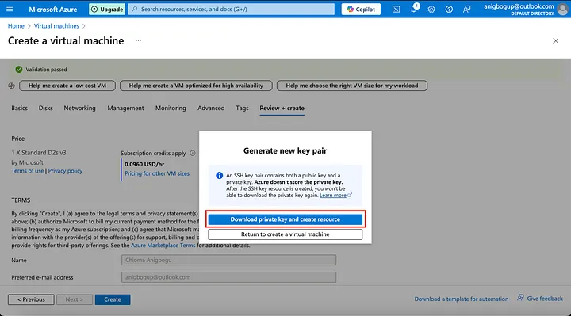
Connect to Linux Virtual Machine
Download the private key file (.pem)
This is essential, as you will need it to connect to the VM. Azure does not store the private key, so save it securely.

Slide 5
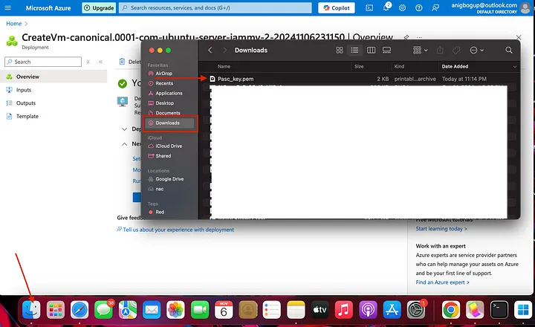
Step 2: Set Permissions on Your Private Key File
For secure access, SSH requires strict permissions on the private key file.
Locate the key file: Open Finder, navigate to the directory where you saved the downloaded .pem file.

Slide 6
Step 2: Set Permissions on Your Private Key File
Set Permissions:
Open Terminal on your MacBook.
Use the chmod command to set secure permissions on the .pem file:
chmod 400 /path/to/your-key-name.pem
Replace /path/to/your-key-name.pem with the full path to the downloaded key file.

Slide 7
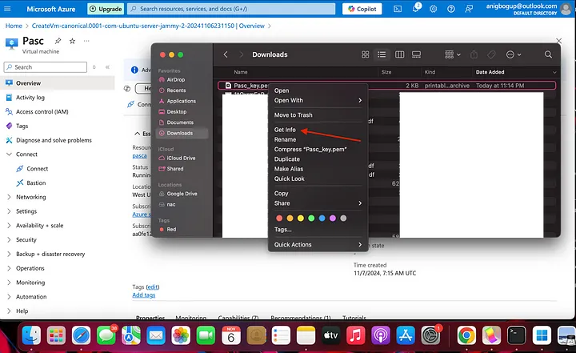
Step 2: Set Permissions on Your Private Key File
OR Locate the key file: Open Finder, navigate to the directory where you saved the downloaded .pem file. Double click on the fileand click on “Get info”

Slide 8
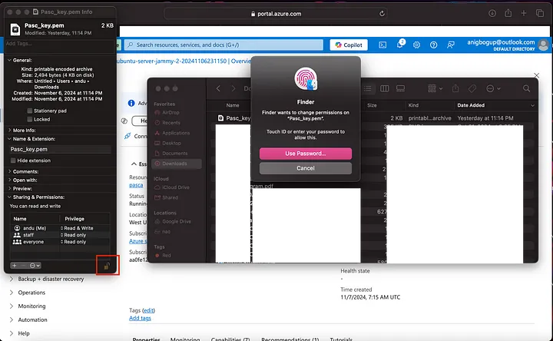
Step 2: Set Permissions on Your Private Key File
Set Permissions: When the file info is open. Click on the key image to make changes to the file. Enter required password or your fingerprint so that you can change permissions to the file.

Slide 9
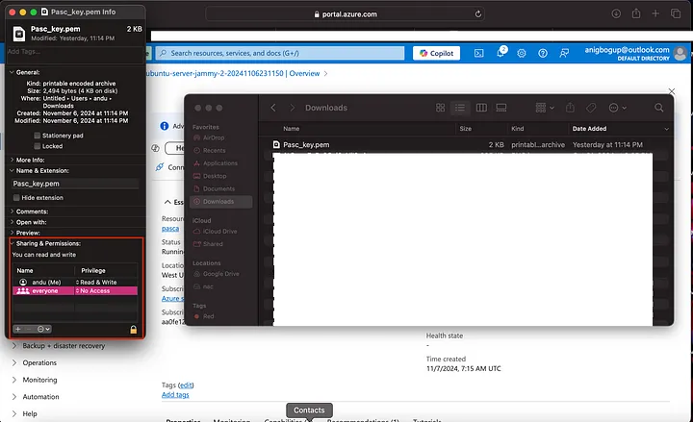
Step 2: Set Permissions on Your Private Key File
Once permissions is granted, remove “staff” by clicking on it and then on the — sign. Then set “everyone” privilege to “ No Access”, click on the lock key to perfect changes. Once done it should be like whats in the image below.

Slide 10
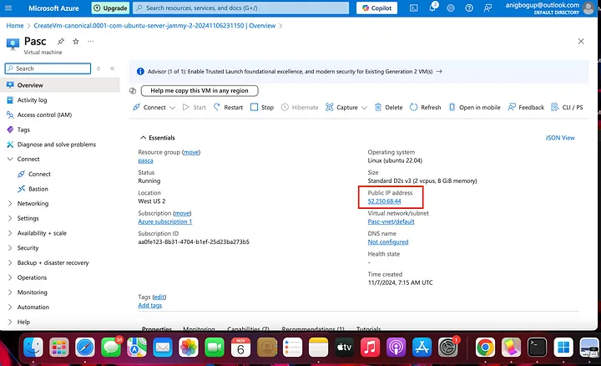
Step 3: Connect to Your Linux VM Using the Azure-Generated SSH Key Pair
Now that your VM is set up, connect to it using the private key file Azure provided.
1.Get the Public IP Address:
In the Azure portal, go to your VM’s overview page, and copy the public IP address.

Slide 11

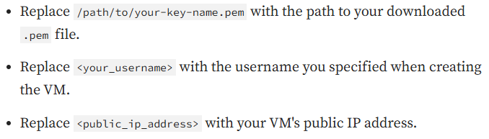
2.Connect via SSH:
Open your terminal and run the SSH command with the path to your private key file:

Slide 12
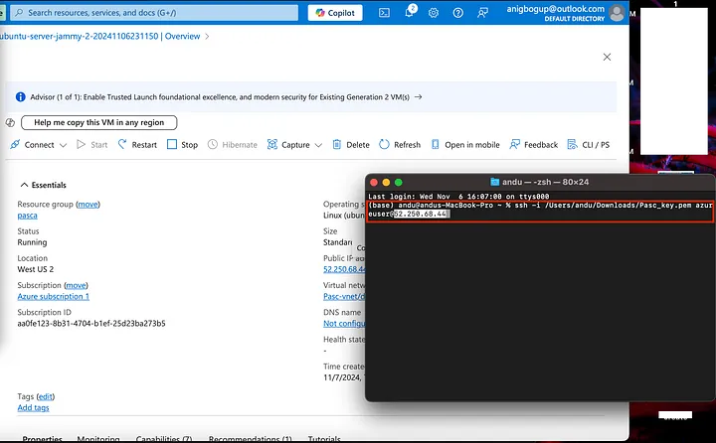
2.Connect via SSH:

Slide 13
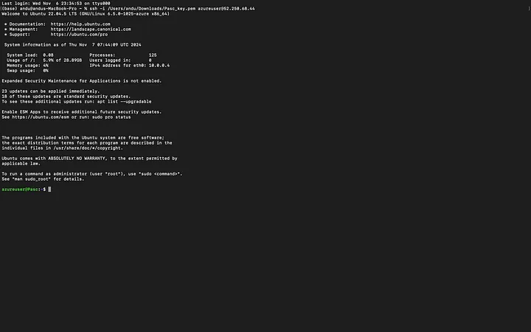
3.Accept the Connection:
The first time you connect, SSH will prompt you to confirm the authenticity of the host. Type yes and press Enter.
4.Passphrase (if set):
If you set a passphrase on the private key, enter it when prompted.
Congratulations! You are now connected to your Linux VM using the Azure-generated SSH key pair.

Slide 14

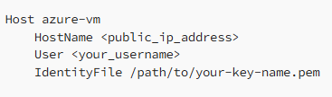
Additional Tips
Download the Key File Once: Remember that Azure only provides the private key file at creation time. If you lose it, you may need to reset the SSH configuration on the VM or generate a new key pair.
Manage SSH Connections: You can simplify your SSH connection using an SSH config file. Open the SSH config file in your terminal:
Add an entry to simplify your SSH command:

Slide 15

Additional Tips
Save and exit by pressing Control + X, then Y to confirm.
Now, connect to your VM with:
Conclusion
Using an Azure-generated SSH key pair to create and connect to a Linux VM is a secure and convenient way to manage access. By following these steps, you can quickly set up and access your VM with minimal configuration, allowing you to focus on your work.

Slide 16

Any Questions ?

